Slide 1
Daniel Fast Recipes for The Mt. Zion Pathfinders
2026

Slide 2
Quick Recipe Links – Eliminate any items that are not Daniel Fast compliant
Daniel Fast Meal Plan and Recipes
Vegan stuffed peppers
Daniel Fast chile recipe
Daniel Fast Tacos
Daniel Fast-soup recipes

Slide 3
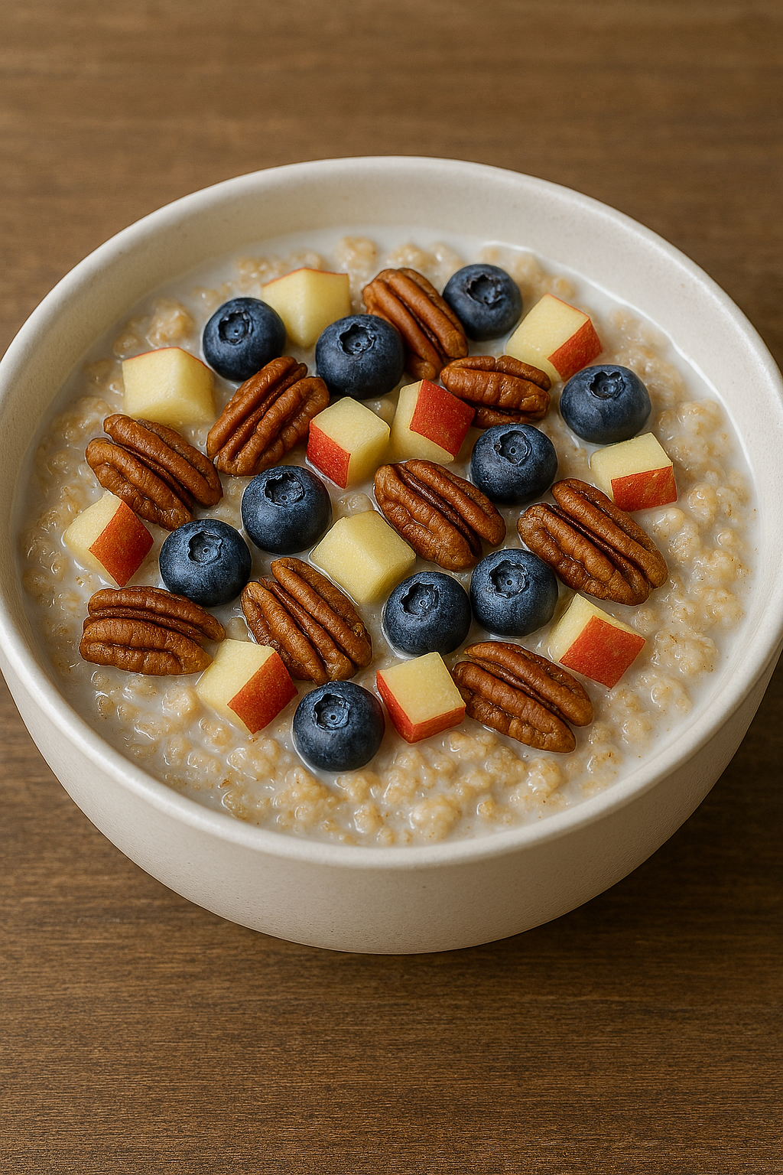
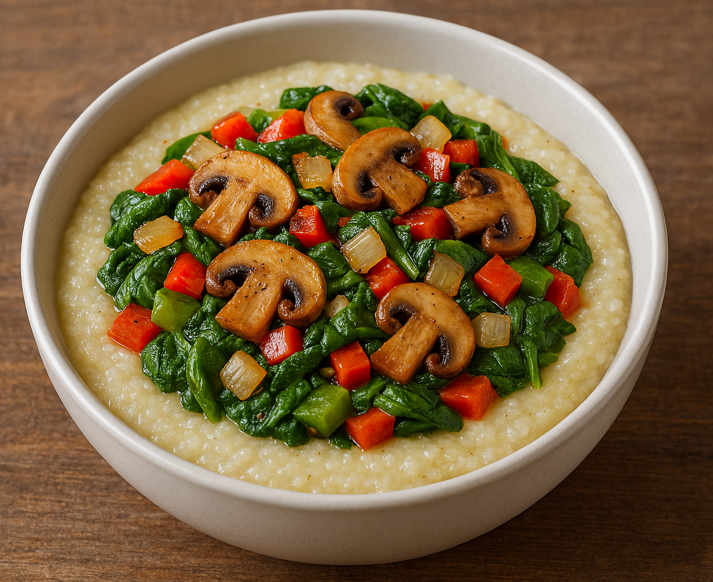

Hot Breakfast: Loaded Oatmeal, Loaded Grits, Loaded Skillet Potatoes
Loaded Oatmeal
Make your oatmeal adhering to Daniel Fast allowances. Chop half an apple and add it to the oatmeal while it’s cooking. Use the following for toppings:
Oat or Almond Milk (optional)
Nuts any kind
Fruit any kind you like - chopped
Add any Berries you want
Remaining chopped apple
Place cooked oatmeal in a bowl and top with plant-based milk and as much nuts and fruits that you want
Loaded Grits
Make your grits adhering to Daniel Fast allowances
Sautee the following vegetables with seasoning in light olive oil
Sliced mushrooms
Diced/ chopped onion
Diced/ chopped red and green bell peppers
Spinach
Place hot cooked grits in a bowl and top with the sauteed vegetables.
Loaded Skillet Potatoes
Dice potatoes into small pieces and season with salt, pepper and herbs of your choice, e.g. Italian seasoning
In a skillet cook potatoes following Daniel Fast allowances for oils for 3 to 4 minutes per side.
Add other vegetables of your choice like chopped onions, red bell peppers.
Continue cooking until potatoes are done to your liking (soft or crispy)

Slide 4
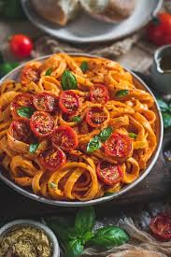
Prayerful Pasta
Boil Daniel Fast approved pasta like whole wheat or whole grain spaghetti and set aside in a skillet
Arrange on a baking sheet and sprinkle with olive oil and seasonings the following vegetables and bake in the oven until done:
1 cup cherry tomatoes - let them blister in the oven
1 whole red bell pepper chopped into large pieces
¼ clove of garlic – soft to the touch and then remove the skin
Sprinkle Italian seasoning mix (e.g. oregano, thyme) and salt
Cracked Black Pepper for finishing touch
You can make
a creamy sauce by tossing the baked vegetables in a food processor or blender (or)
mix the veggie pieces directly into the finished pasta

Slide 5
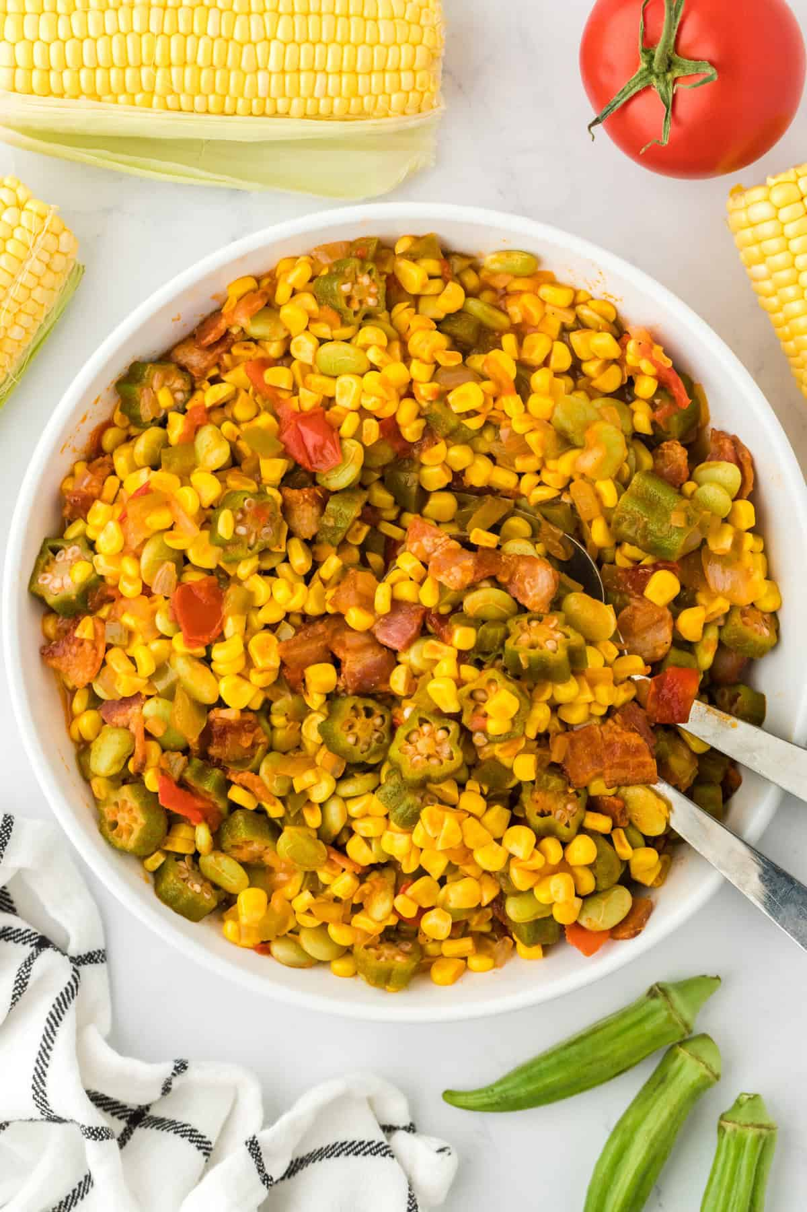
Serve Any Veggies on Brown or Wild Rice For a Hearty Meal
SUCCOTASH
1 small onion minced
1 green pepper cored, seeded and minced
1 cup frozen lima beans
2 cups fresh or frozen corn nibblets thawed and drained if frozen
2 small tomatoes cored and chopped
½ teaspoon salt
½ teaspoon ground black pepper (to your taste)
1/2 cup water
okra sliced 1/4 inch thick to equal 1 cup

Slide 6
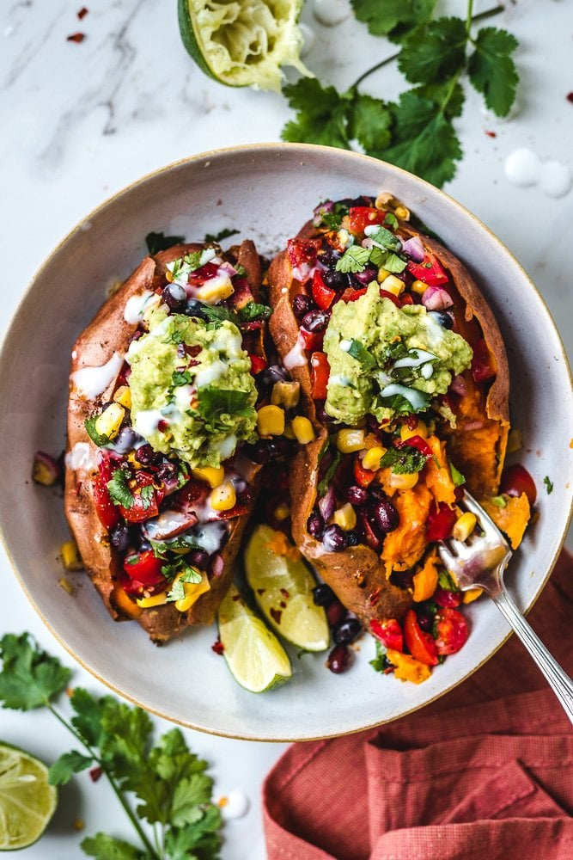
Mexican Stuffed Sweet Potatoes
Poke holes in 2 sweet potatoes and bake at 400F for approx. 40-minutes or until tender
Black Bean Medley – Mix together and put on top of Baked Sweet Potatoes
1 can (400 ml) black beans , strained and rinsed (or 1 1/2 cups cooked black beans)
1 cup cherry tomatoes chopped
1/2 cup corn
1/3 cup cilantro chopped, tightly packed
1/4 cup red onion diced
1 clove garlic diced
1/2 lime juiced
2 tsp olive oil
1/4 tsp sea salt
pinch pepper
pinch chili flakes
Easy Guacamole (for extra topping)
1 avocado
2 tsp lime juice
pinch sea salt

Slide 7
Daniel Fast Compliant Stuffed Potato Ideas
Use Daniel Fast compliant fillings and avoiding restricted items like cheese, butter, sour cream, and meat.
Stuff Potato Southwest Style: Mash the potato flesh with black beans, corn, diced red peppers, onion, spinach, jalapeños, chili powder, and cumin. Top with a homemade avocado drizzle blended with lemon, cilantro, and water.
Stuffed Potato Mushroom & Spinach: Sauté mushrooms, garlic, and spinach in olive oil, then mix with the potato flesh and stuff the skins.
Stuffed Potato Veggie Medley: A simple stuffing of various sautéed vegetables like broccoli, carrots, peppers, and onions, seasoned with garlic powder, paprika, salt, and pepper.

Slide 8

Daniel Fast Fries and Salads
SWEET POTATOE FRIES
Sweet potatoes: 4 medium sized sweet potatoes.
Oil: Olive oil for the pan.
Classic Seasonings: combination of kosher salt, pepper and garlic powder. Sea salt could be used in place of kosher salt.
Directions:
Cut sweet potatoes into French Fry matchsticks. Peel your sweet potatoes and cut off both ends. Slice into French Fry shapes.
Place on baking sheet: in a single layer on a baking sheet lined with foil or parchment. Toss with olive oil.
Bake: Oven bake at 415 degrees F for 15 minutes. Mix together the seasonings and sprinkle evenly over the fries. Then flip them and bake an additional 10-15 minutes, or until crisp.
KALE AND APPLE SALAD WITH WALNUTS
Massage kale leaves with a dressing made of ((applesauce (toss a few apples into a blender or food processor), olive oil, and juice from squeezed lemon)), then toss with chopped apples, mandarin oranges, and walnuts.
SPINACH & MIXED GREENS WITH ALMONDS AND SUNFLOWER SEEDS:
Combine spinach and romaine lettuce with clementine segments, celery, and green onions. Top with slivered almonds and raw sunflower seeds, and use an Citrus Herb dressing (made with juice from squeezed oranges, olive oil, Italian herbs).

Slide 9
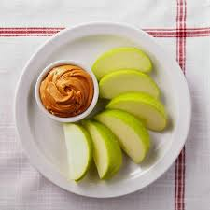
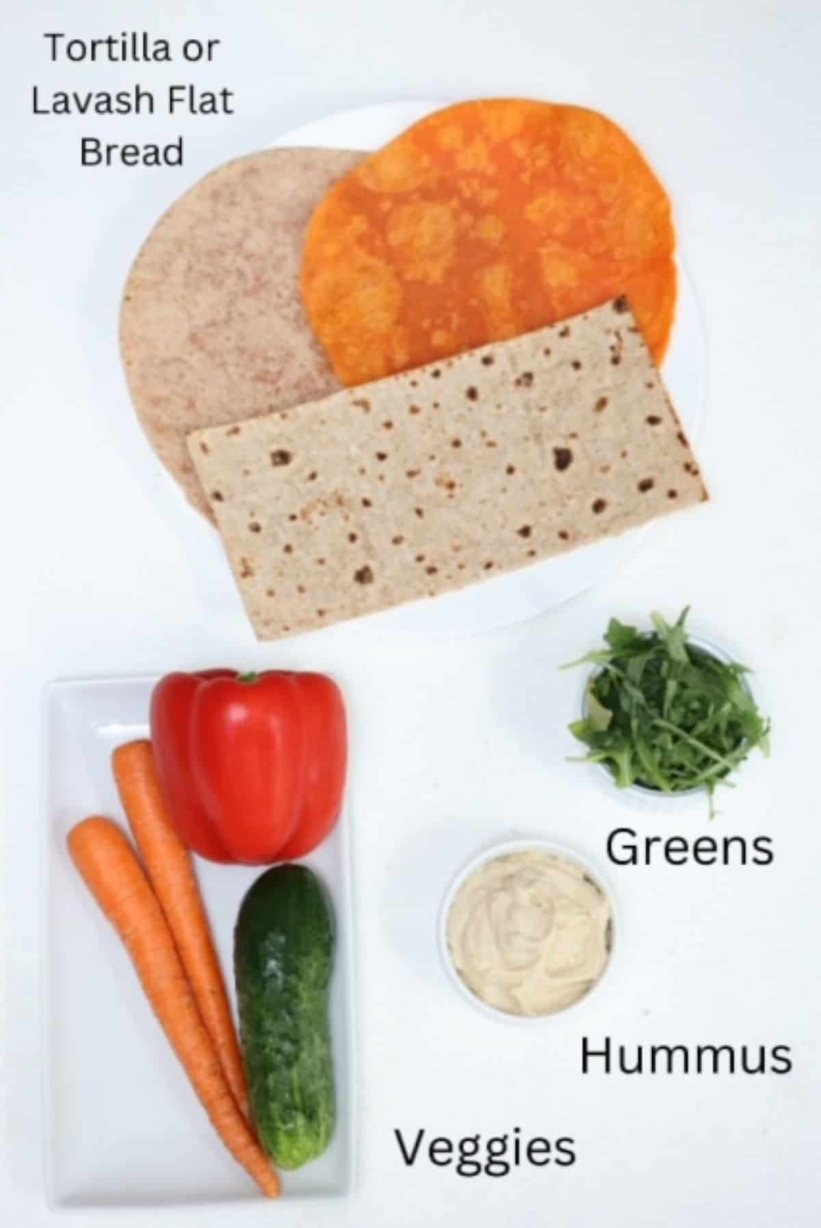
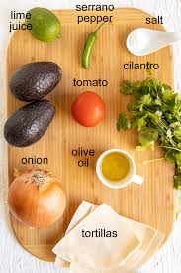
Daniel Fast Quick Snacks
Use Daniel Fast compliant items. Use these ideas for quicks snacks for dipping and for wraps!
Hummus: with veggies like carrot sticks, cucumbers, celery and compliant unleavened bread like whole wheat tortillas. Use this quick & easy to make hummus recipe: https://www.thewholesomedish.com/simple-hummus-without-tahini/ .
Peanut or Almond Butter and Apples: Slice apples and spread on the nut butter.
Guacamole: mashed avocado with diced onion, chopped cilantro, chopped tomatoes, serrano or jalapeno pepper, fresh lime juice and a pinch of salt. Directions at recipe best-ever-guacamole
In the oven toast whole wheat tortillas dusted with chile powder and small amount of olive oil and cut into wedges. Serve with the tortilla and your choice of cut vegetables.

