Slide 1
ANCIENT HOPE
An Fearful Heart

Slide 3
Rise of the Meme

Slide 6
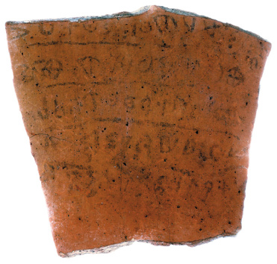
Mentions election of King Saul

Slide 7
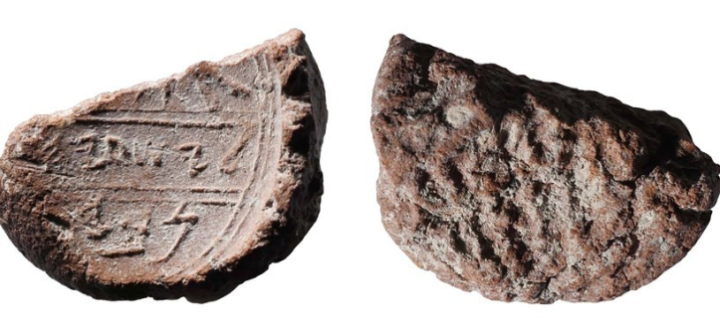
Seal of Isaiah the Prophet

Slide 8
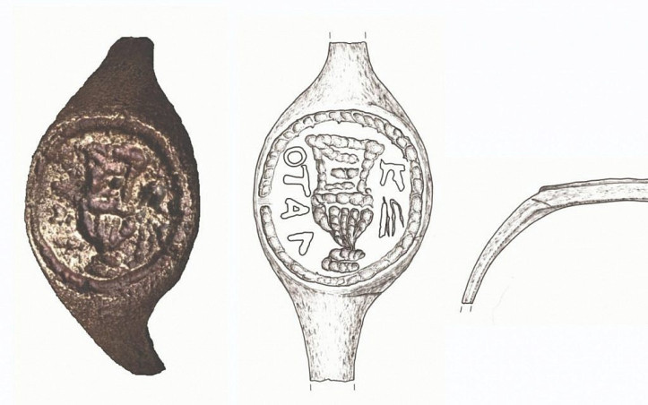
Seal Ring of Pontius Pilate

Slide 9
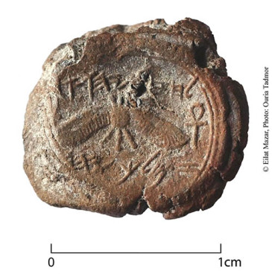
Seal Ring of King Hezekiah

Slide 10
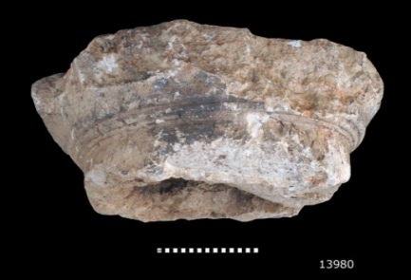
TEMPLE: Decorated Column

Slide 11
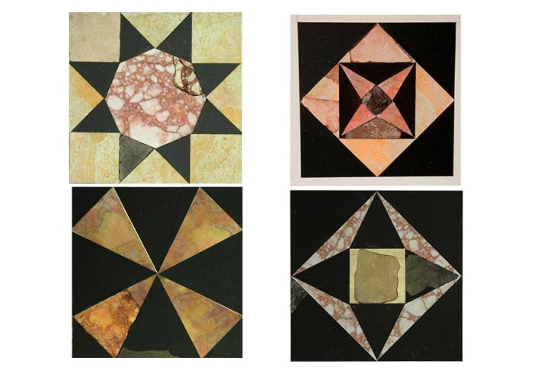
TEMPLE: Floor Mosaics

Slide 12
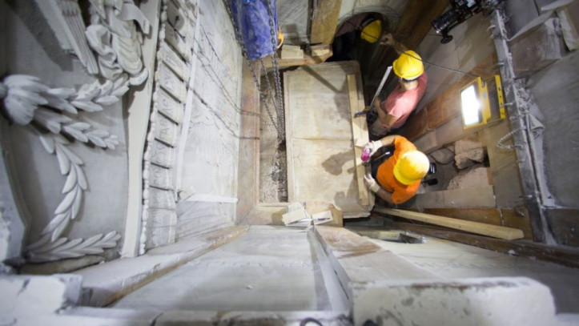
TOMB OF JESUS DATE CONFIRMED

Slide 13
TOMB OF JESUS DATE CONFIRMED

Slide 14
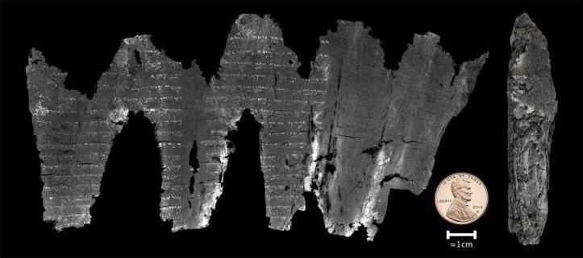
Scroll dating linked Dead Sea Scrolls to Hebrew Testament

Slide 15
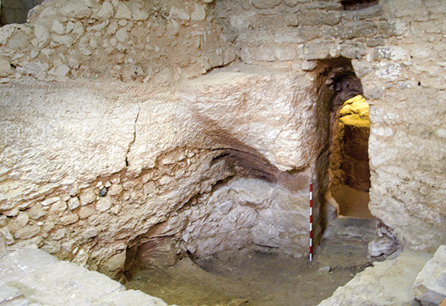
Childhood Home of Jesus discovered

Slide 16
History of Israel
1 Chronicles 1 & 2 Samuel
2 Chronicles 1 & 2 Kings

Slide 17
LUKE- Mary’s line
MATTHEW- Joseph’s line
Chronicles:
The Gospels:

Slide 18
The Gospel According to
MATTHEW 2:1ff
Pg. 668-669

Slide 19
Daniel’s Prophesy

Slide 20
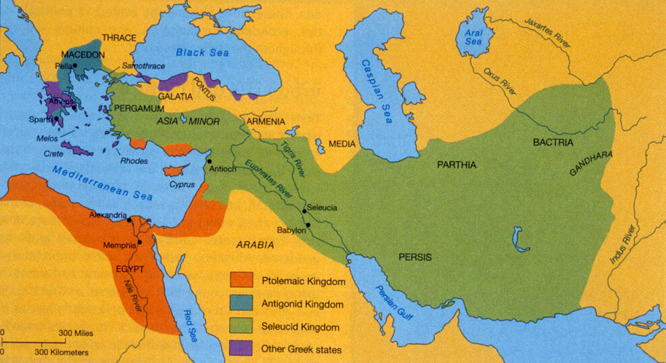
Greek
Kingdoms

Slide 22
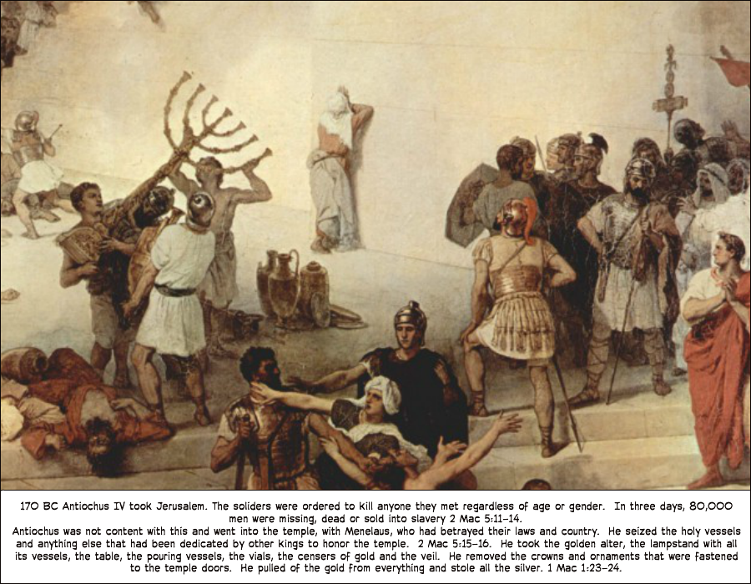
169 BC

Slide 23
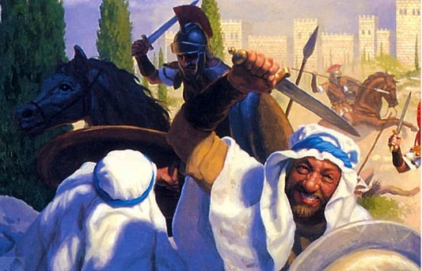
167 BC

Slide 24
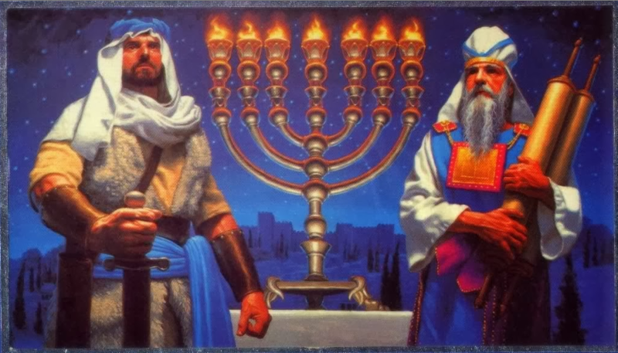
165 BC

Slide 25
“the light is kindled to give inspiration,
for the light of Messiah must burn brightly in our hearts.”

Slide 26
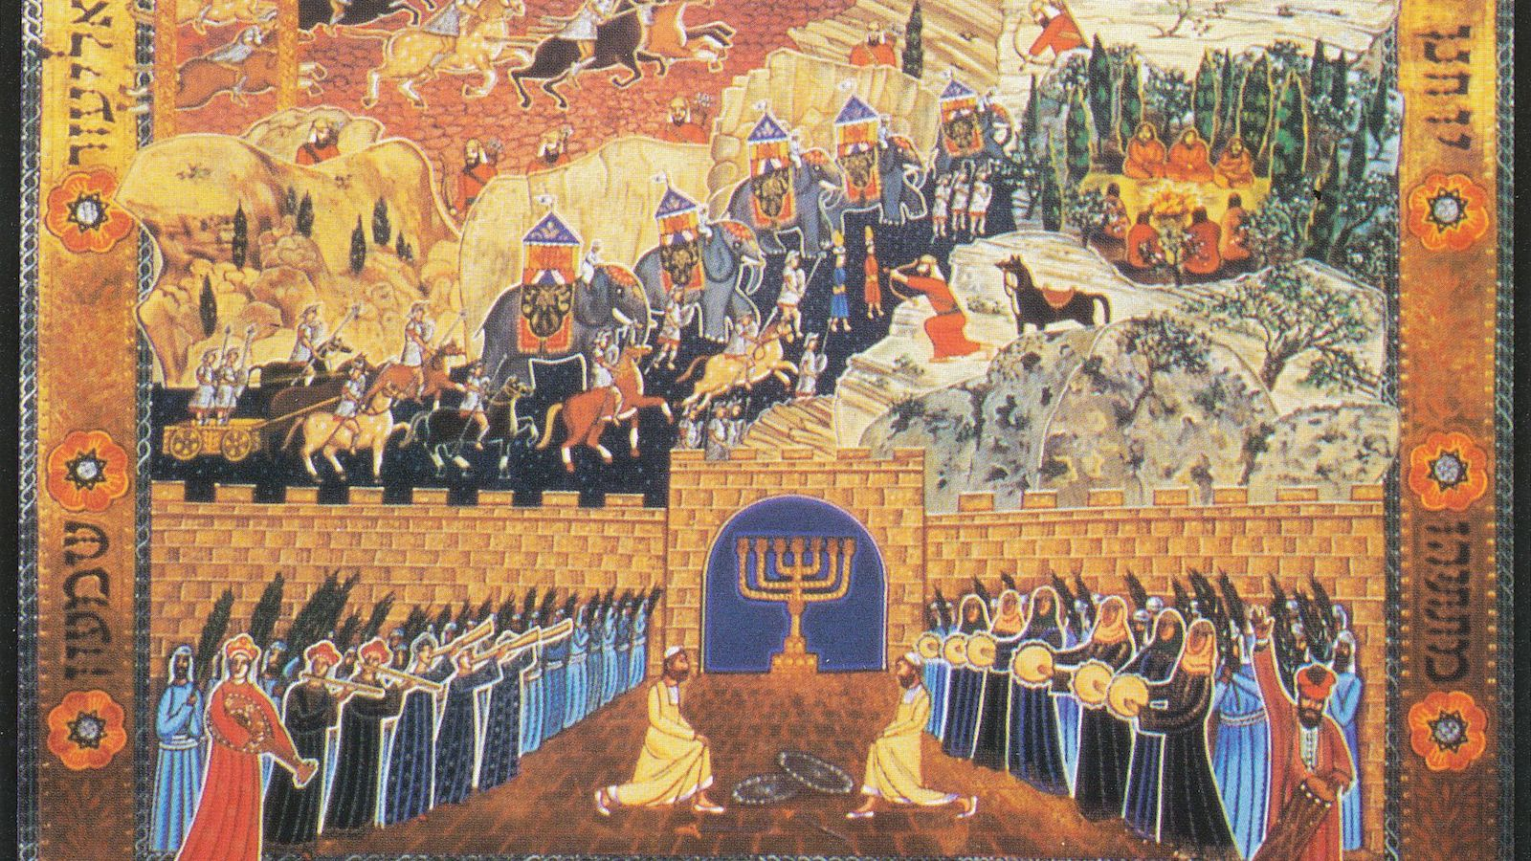
64 BC

Slide 27
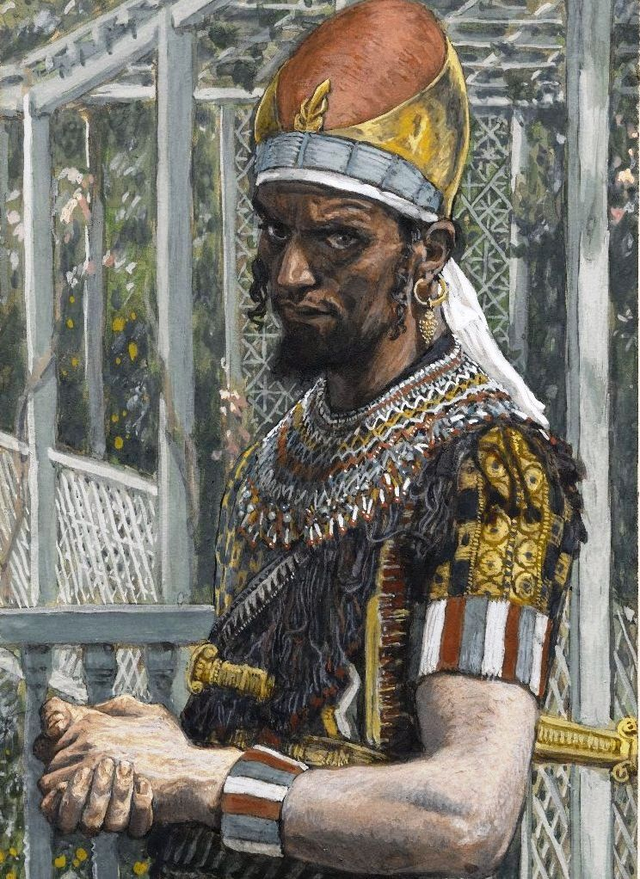
37 BC
Herod
the Great ruled
until
4 BC

Slide 28
The Gospel According to
MATTHEW 2:1ff
Pg. 668-669

Slide 29
a star will step forth from Jacob,
a scepter will arise from Israel
Numbers 24:17

Slide 30
The Gospel According to
MATTHEW 2:2ff
Pg. 668-669

Slide 32
The Gospel According to
MATTHEW 2:4ff
Pg. 668-669

Slide 33
NOW WHAT?

