Slide 2
Chapter 2

Slide 3
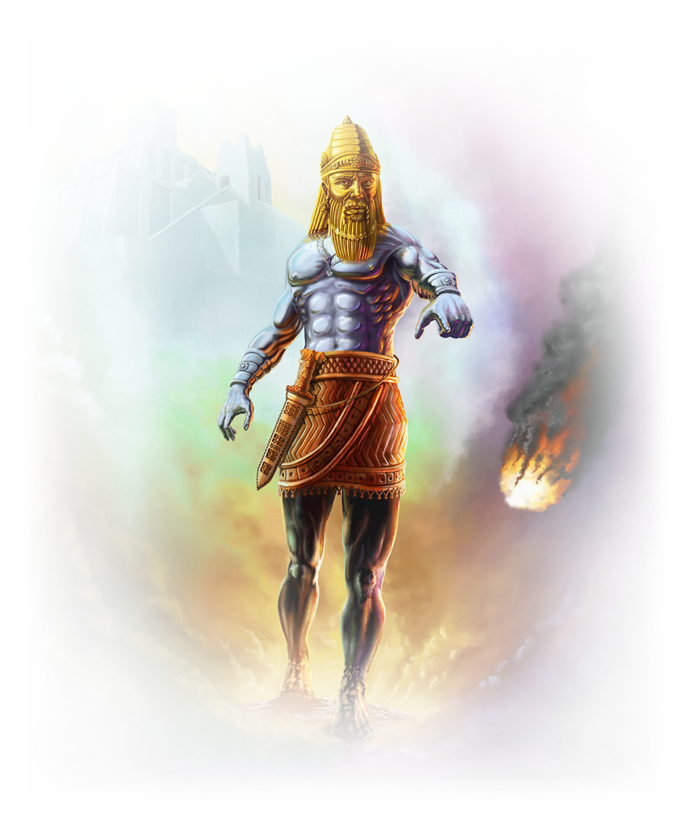
Nebuchadnezzar’s Dream- Chapter 2
HEAD
Gold
CHEST & ARMS
Silver
BELLY & THIGHS
Bronze
LEGS
Iron
FEET
Part Iron & Part Clay
ROCK

Slide 4
Nebuchadnezzar’s Dream- Chapter 2
HEAD
Gold
CHEST & ARMS
Silver
BELLY & THIGHS
Bronze
LEGS
Iron
FEET (10 toes)
Part Iron & Part Clay
ROCK
BABLYLON
MEDIA & PERSIA
GREECE
ROME
EAST & WEST ROMAN EMPIRE
& REMNANT
JESUS’ MESSIANIC KINGDOM

Slide 5
Chapter 7

Slide 6
Chapter 7
HEAD
Gold
CHEST & ARMS
Silver
BELLY & THIGHS
Bronze
LEGS
Iron
FEET (10 toes)
Part Iron & Part Clay
ROCK
LION
BEAR
LEOPARD
BEAST
10 HORNS
SON OF MAN
BABLYLON
MEDIA & PERSIA
GREECE
ROME
FROM ROME
JESUS’ MESSIANIC KINGDOM

Slide 7
Chapter 8

Slide 8
Chapter 8
HEAD
Gold
CHEST & ARMS
Silver
BELLY & THIGHS
Bronze
LEGS
Iron
FEET
Part Iron & Part Clay
ROCK
LION
BEAR
LEOPARD
BEAST
10 HORNS
SON OF MAN
BABLYLON
MEDIA & PERSIA
GREECE
& Remnant
MESSIANIC KINGDOM
RAM
GOAT

Slide 9
Chapter 9

Slide 10
4 times are given in 9:25
MEDIA & PERSIA
MESSIANIC KINGDOM
70-7s = 490 years total from decree by Cyrus
7-7s = 49 years to restore and rebuild Jerusalem
62-7s = 434 the Messiah will come & Die
Final 7 = y years
Subdivided in ½ = 3/5 years

Slide 11
NOW WHAT?
How is God calling you
to be obedient?

