Slide 1
Mobile Baptist Sunlight District Association Woman’s Auxiliary Theme: RAISING THE STANDARD THROUGH CHRISTIAN MINISTRY Isaiah 62:10 KJV EMPHASIS: “IT’S TIME TO FULFILL THE ASSIGNMENT!” Isaiah 61:1-4 KJV June 8,2023

Slide 2
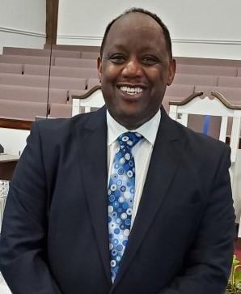
Reverend David L. Frazier, Sr. Moderator
Pastor
Revelation Baptist Church

Slide 3
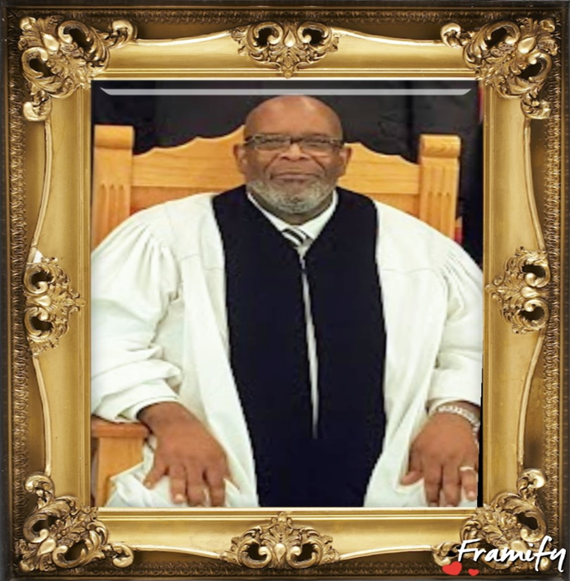
Reverend James Parrish Jr. 1st Vice Moderator
Pastor
Greater Nazaree Baptist Church

Slide 4
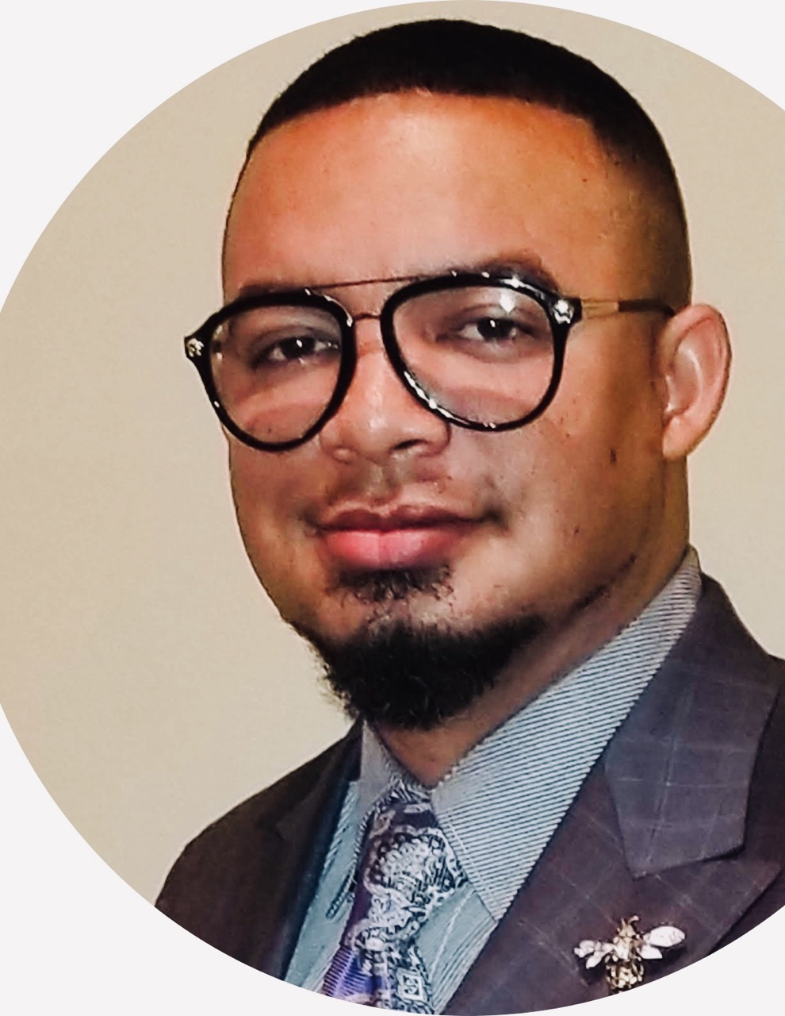
Reverend Dr. Joseph Laffiette II 2nd Vice Moderator
Pastor
Bethlehem Baptist Church

Slide 5
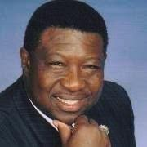
Reverend Cleveland McFarland, Jr. Moderator Emeritus
Pastor
St. Peter Baptist Church

Slide 6
Mobile Baptist Sunlight District Woman’s Auxiliary Officers

Slide 7
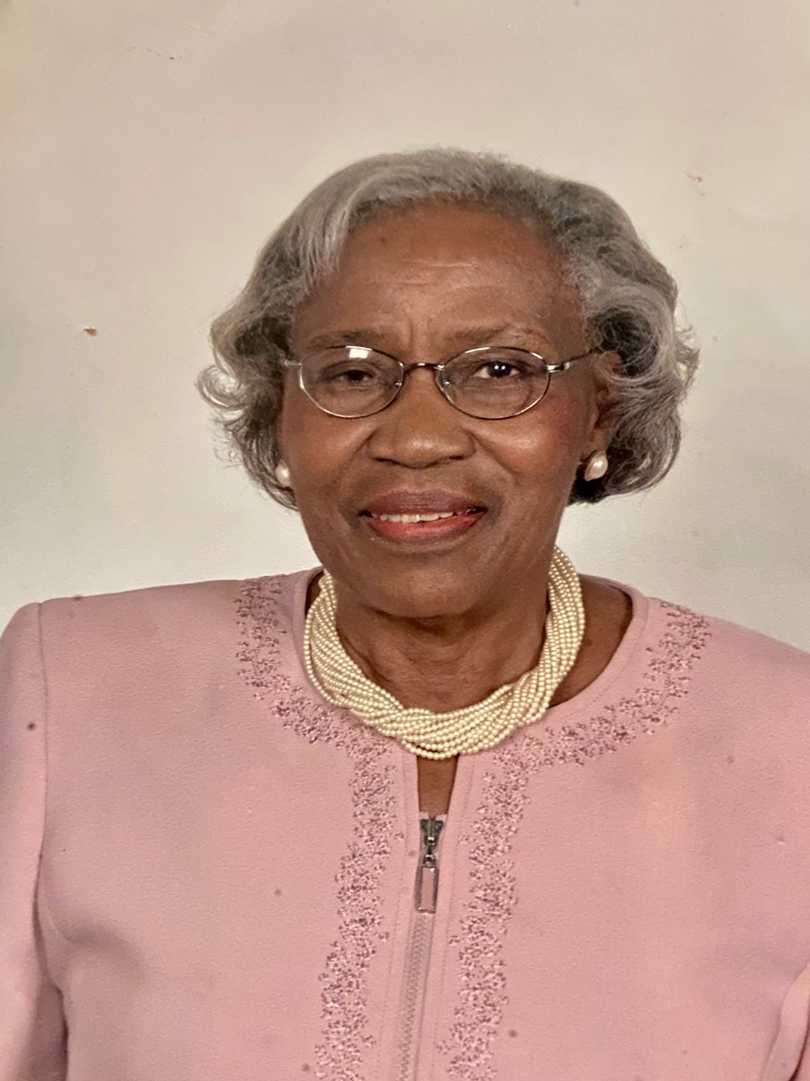
Dr. Lelia J. English
President Emerita
Stone Street Baptist Church

Slide 8
Mrs. Nettie M. Curtis
Past President
St. Joseph Missionary Baptist Church

Slide 9
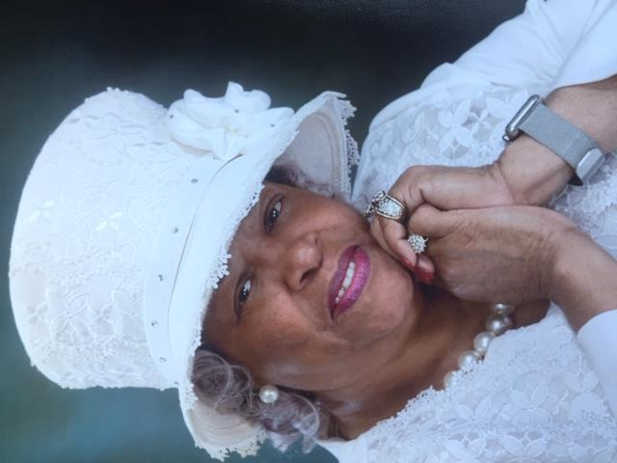
Sister Althea Ford
President
Corinthian Missionary
Baptist Church

Slide 10
Sister Deborah Kennedy
1st Vice President
Revelation
Baptist Church

Slide 11
Sister Diane Inge
2nd Vice President
Greater Nazaree Baptist Church

Slide 12
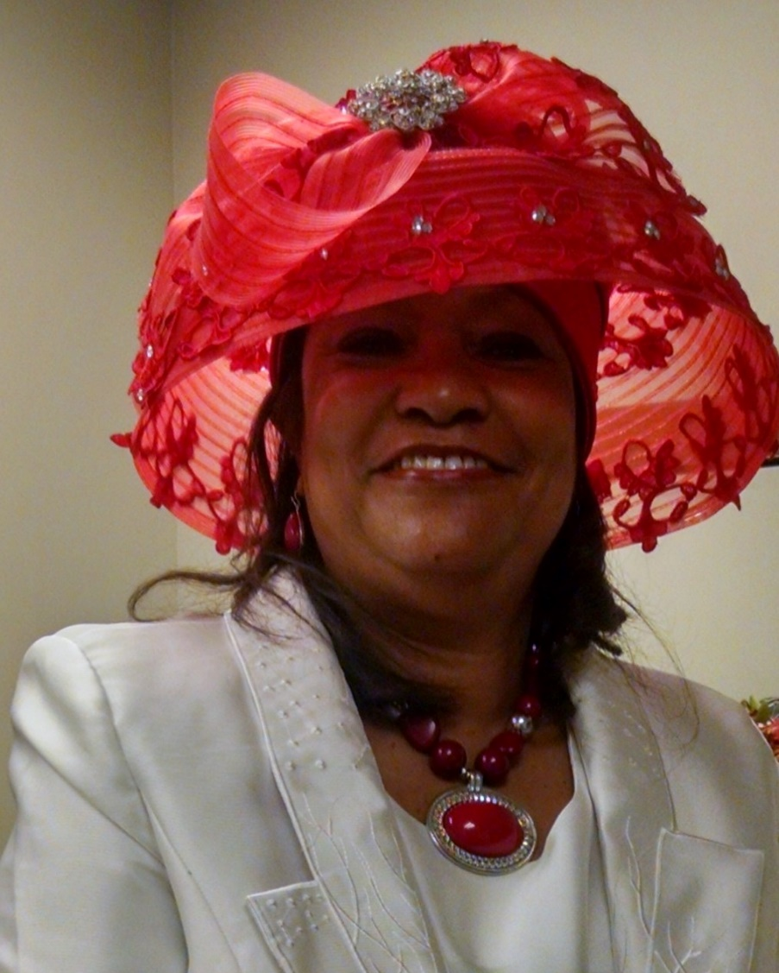
Sister Diana Chapman
Recording Secretary
Friendship
Cody Road

Slide 13
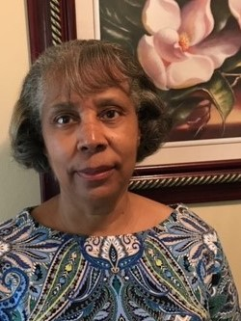
Sister Linda Todd
Assistant Recording Secretary
First Baptist
Prichard

Slide 14
Sister Jesse Cox
Corresponding Secretary
Revelation
Baptist Church

Slide 15
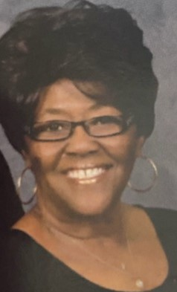
Assistant Corresponding Secretary
Sister Diane Samuels
Corinthian
Baptist Church

Slide 16
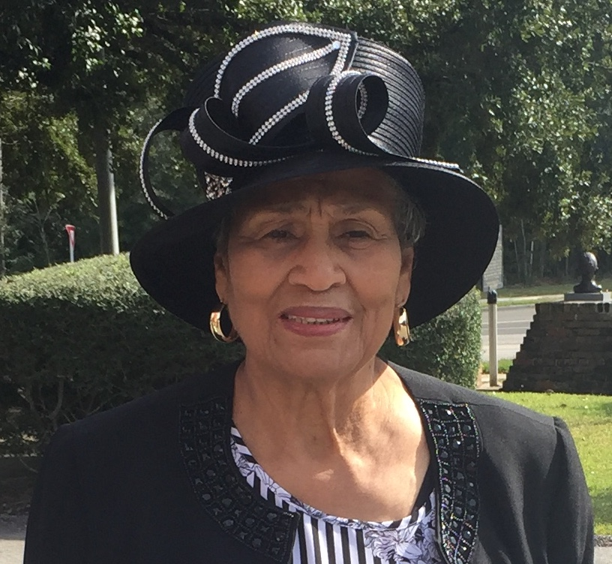
Sister Daisy Porter
Parliamentarian
Green Grove Baptist Church

Slide 17
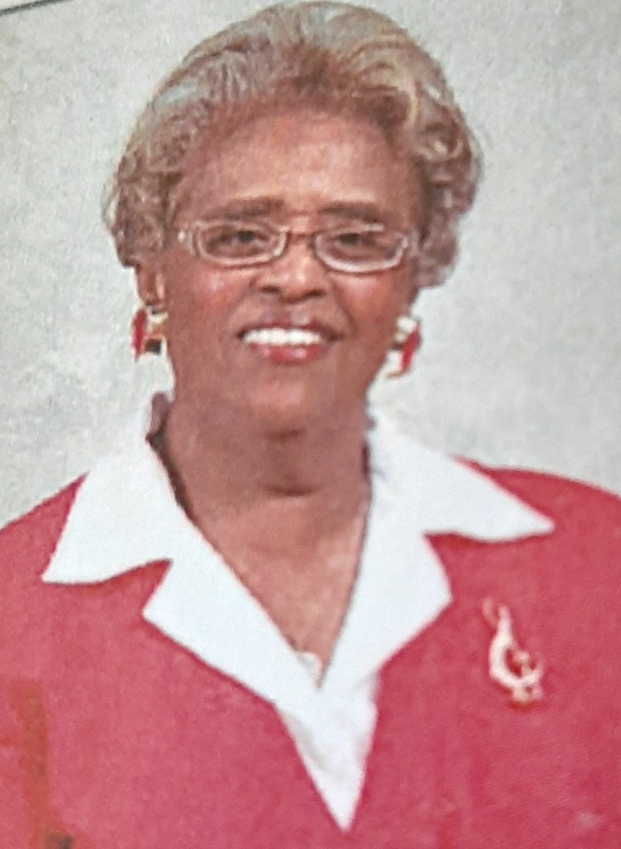
Sister Eugenia Rankins
Directress of Music
Revelation Baptist
Church

Slide 18
Sister Mary Ida Lummas
Historian
Tabernacle Baptist Church

Slide 19
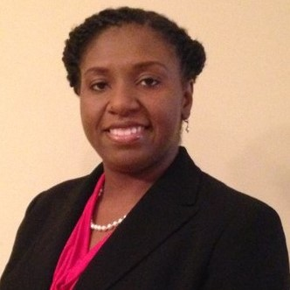
Sister Davida Williams
Administrative Assistant
Mt. Sinai Baptist
Church
Whistler

Slide 20
Sister Adline Gulley
Assistant Financial Secretary
Tabernacle Baptist
Church

Slide 21
Sister Linda Payne
Financial Secretary
Truevine Baptist
Church

Slide 22
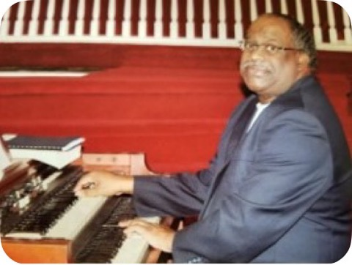
Music Auxiliary President
Organist
STONE STREET
BAPTIST CHURCH
Brother Derrick L. Coleman

Slide 23
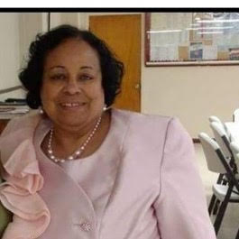
Sister Donna Henderson
Pianist

Slide 24
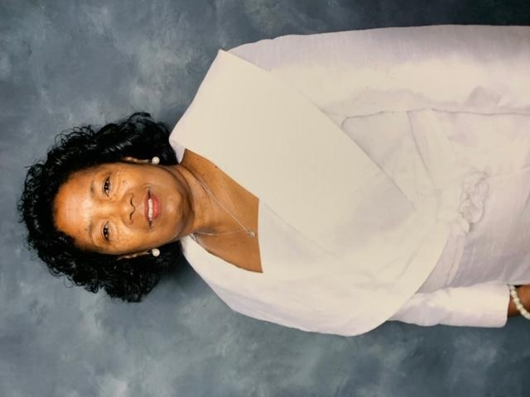
Sister Brenda Maye
Minister’s Wives Chairperson
Liberty Baptist Church

Slide 25
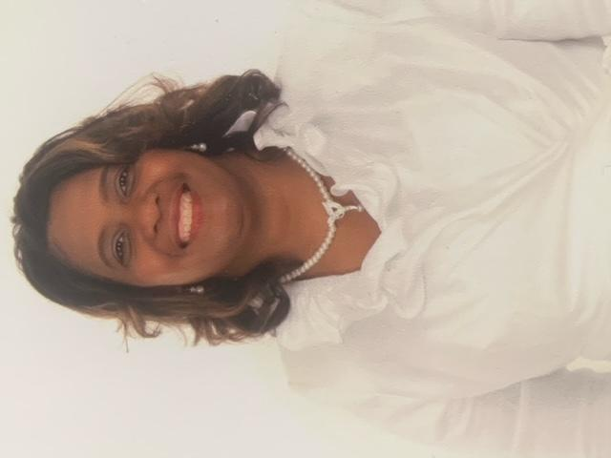
Sister Annicer Bendolph
Deaconess Chairperson
Amity
Baptist Church

Slide 26
Sister Janell Hamilton
Matrons 2nd Vice President
New Jerusalem
Baptist Church

Slide 27
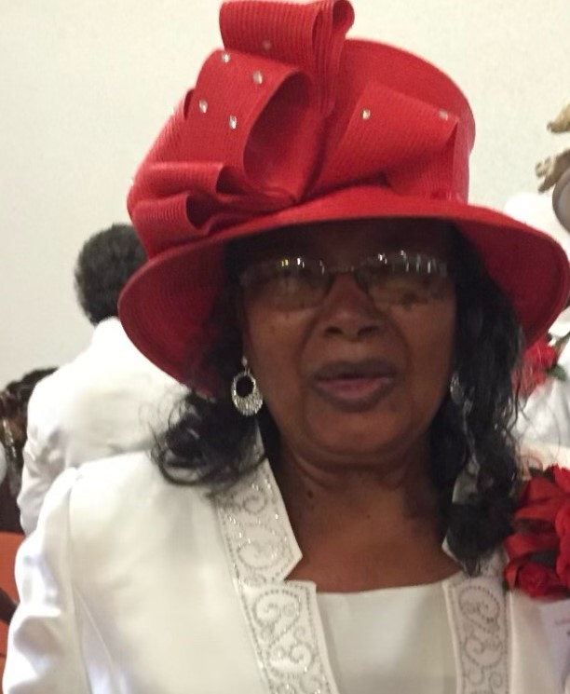
Sister Love Wright
Matrons Counselor
Greater Union
Baptist Church

Slide 28
Sister Carrie Warmack
Ushers Chairperson
Third Baptist Church

Slide 29
Sister Virginia Lockhart
Nurses Guild Chairperson
Holmes Street
Baptist Church

Slide 30
Sister Shelia Hale
Mission Coordinators Chairperson
New Jerusalem Church

Slide 31
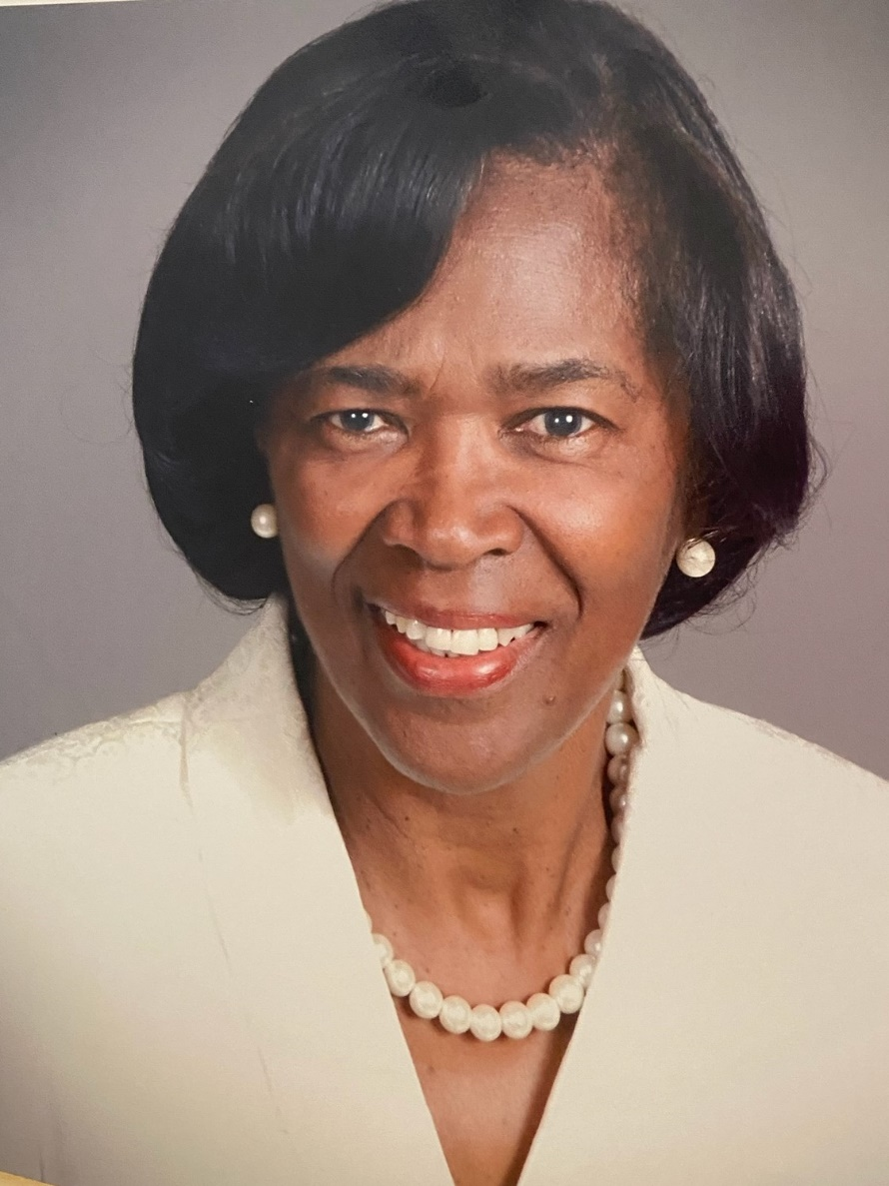
Sister Deborah Carter
Jail Ministry / Mission Study Lecture Chairperson
Lily Baptist
Church

Slide 32
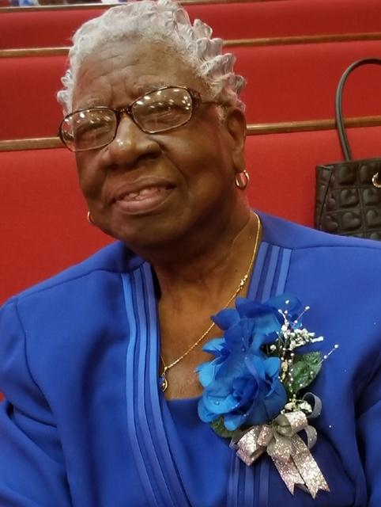
In Memory of Sister Emma Gray
Memorials Chairperson
Mt. Carmel Baptist Church

Slide 33
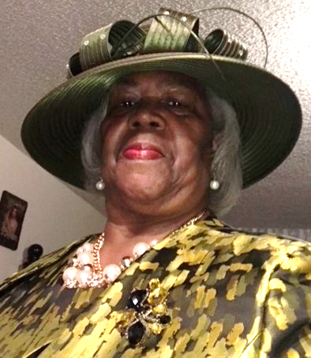
Sister Ruby Morris
Courtesy / Hospitality Chairperson
Holmes Street
Baptist Church

Slide 34
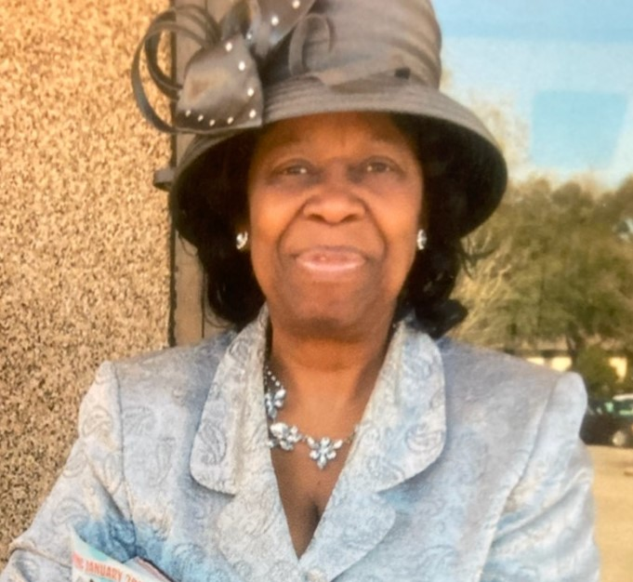
Sister Cecelia Perry
Conference Souvenir Kit Chairperson
Revelation
Baptist Church

Slide 35
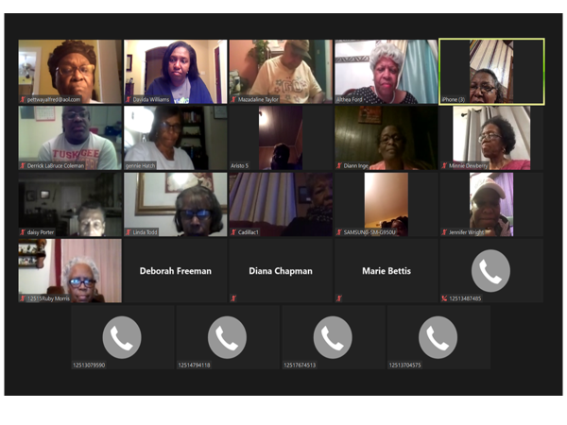
Mission of Power (MOP)
MISSION NIGHT MONTHLY GATHERING
IN THE NEW NORMAL

Slide 36
Mobile Baptist Sunlight Fashion Share Sorting and Distributing Personal Items 2022

Slide 37
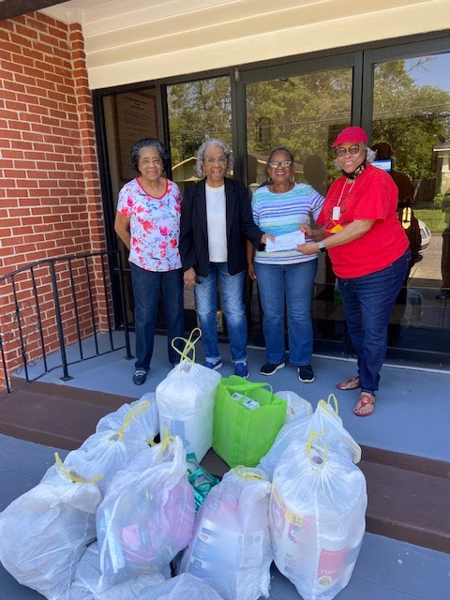
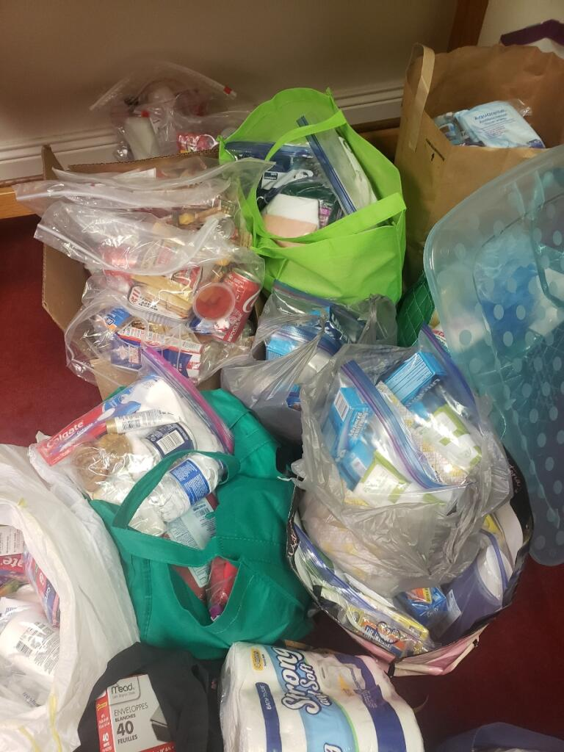

Slide 38
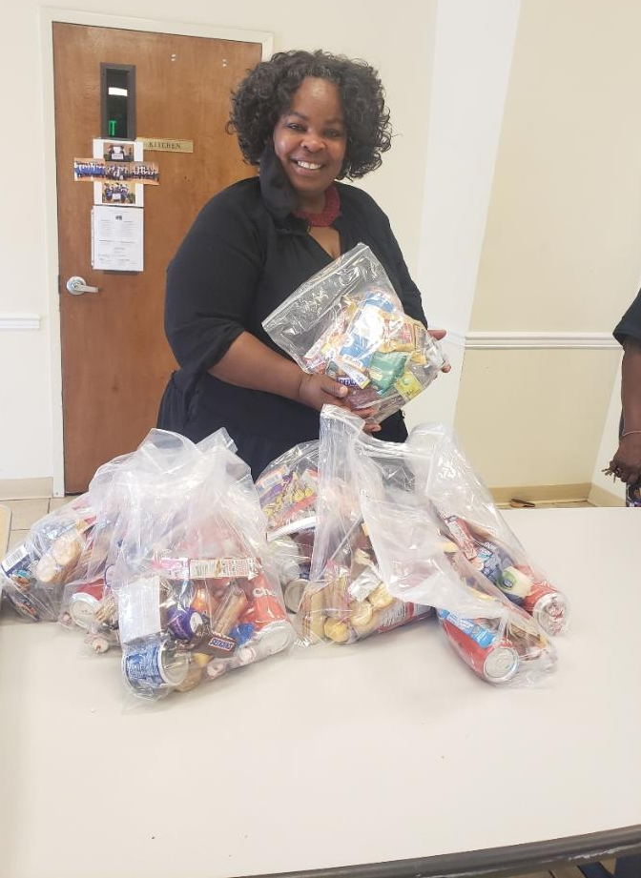
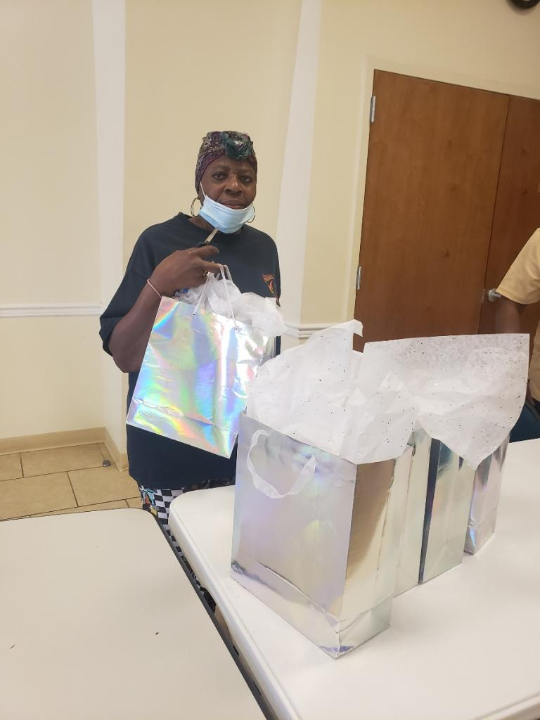

Slide 39
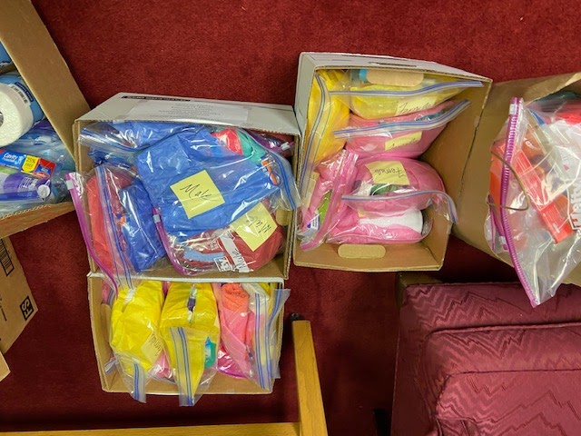
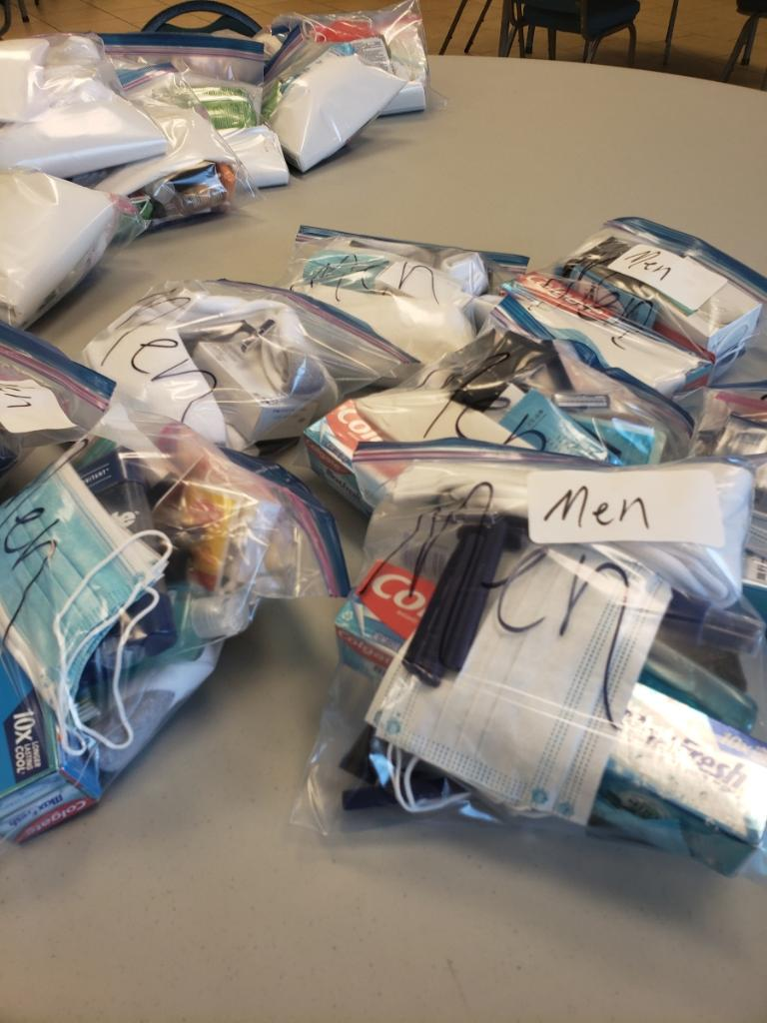

Slide 40
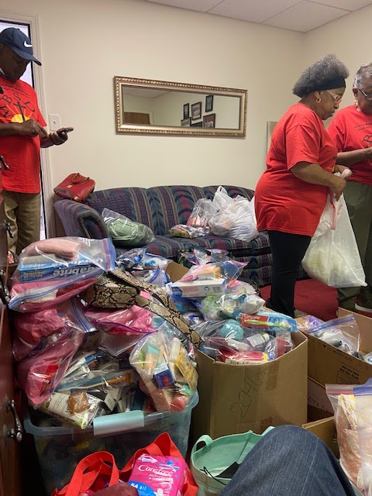
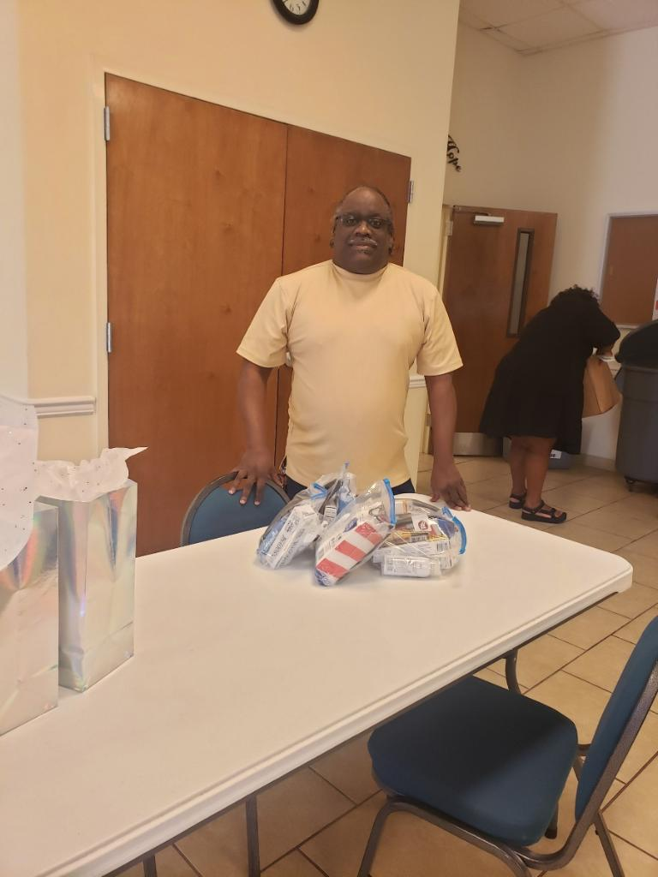

Slide 41
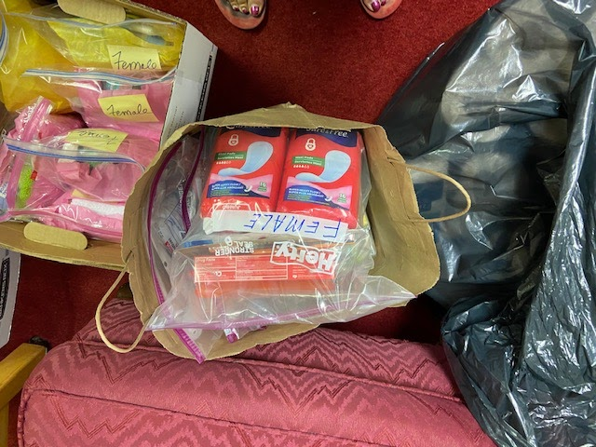
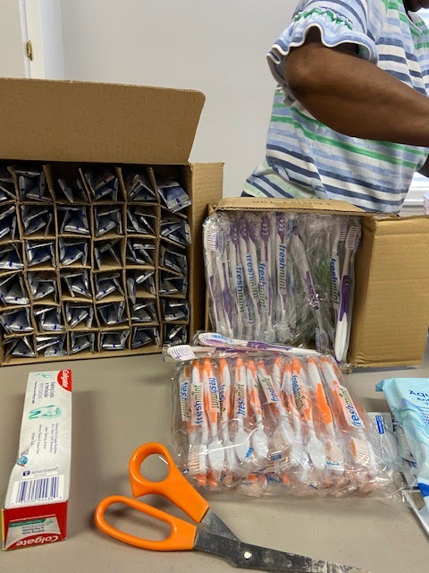
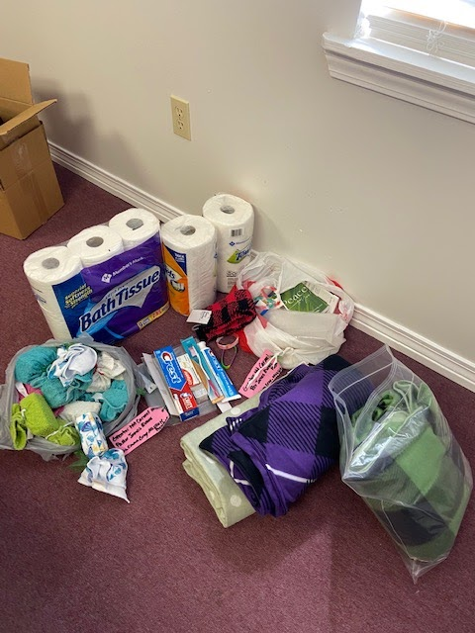

Slide 42
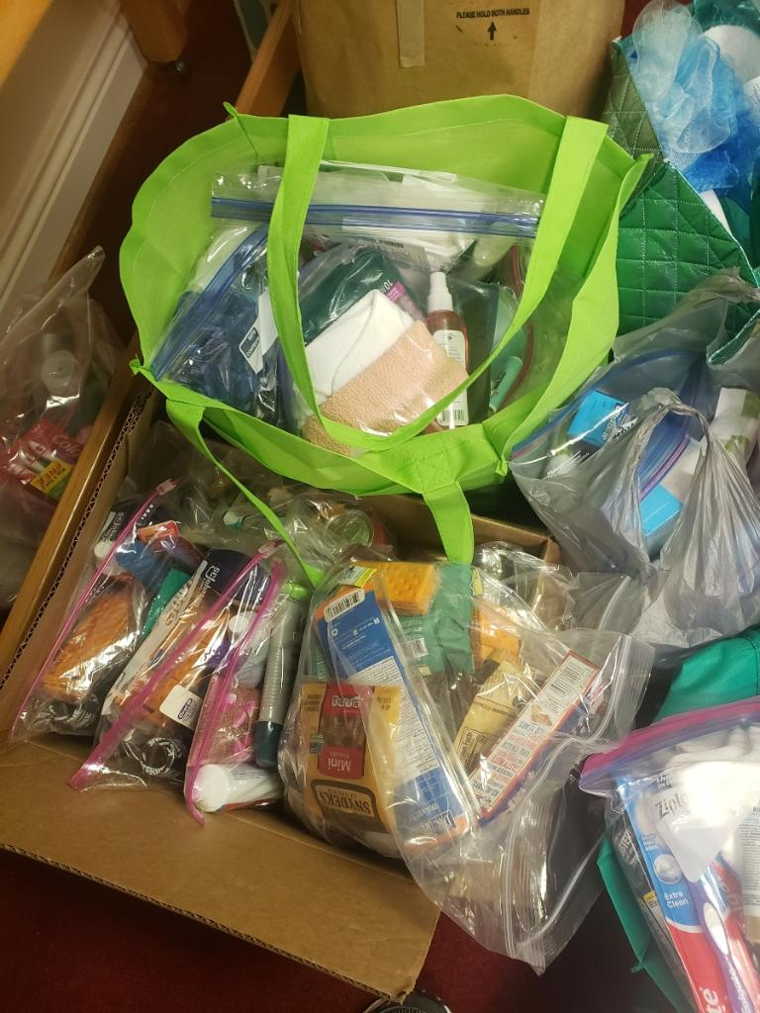
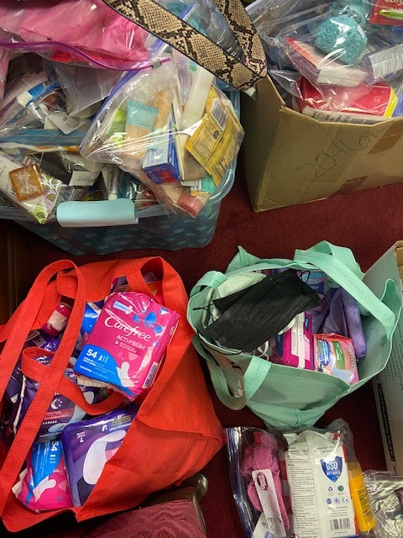

Slide 43
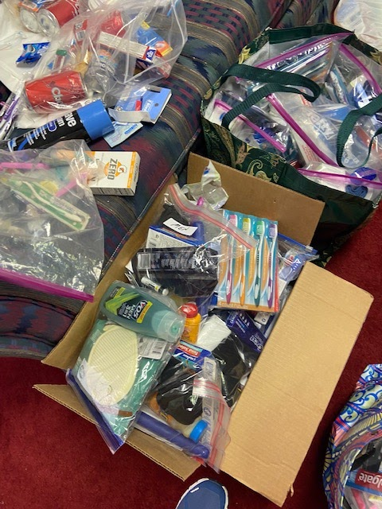
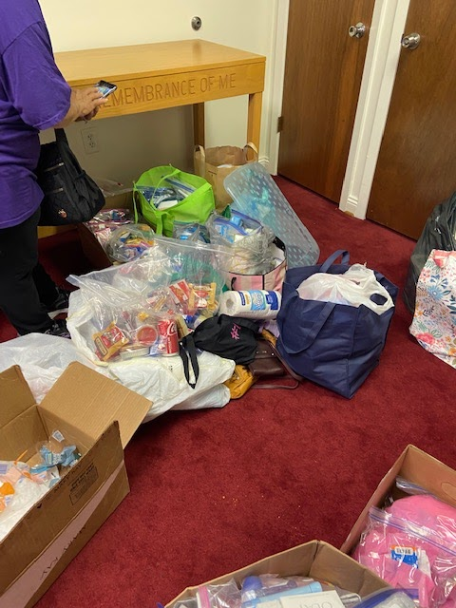

Slide 44
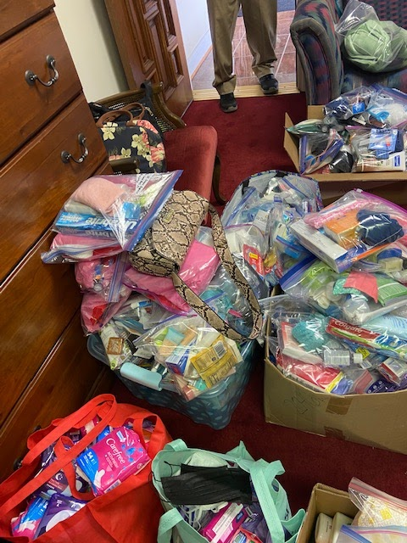
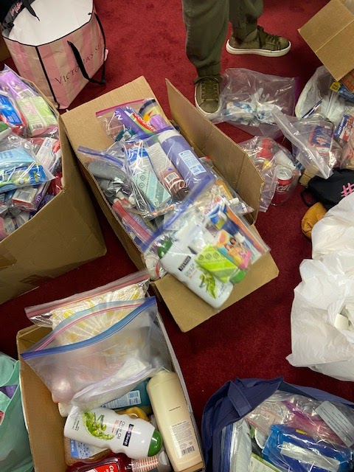

Slide 45
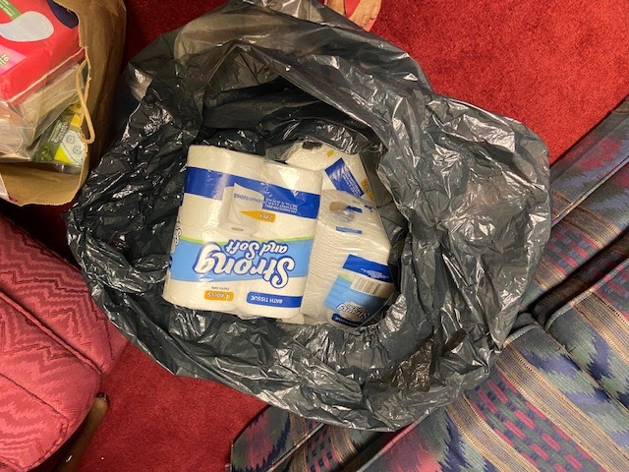
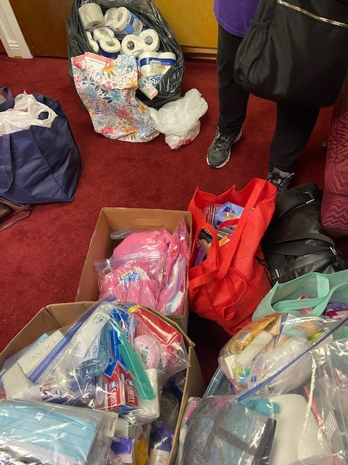
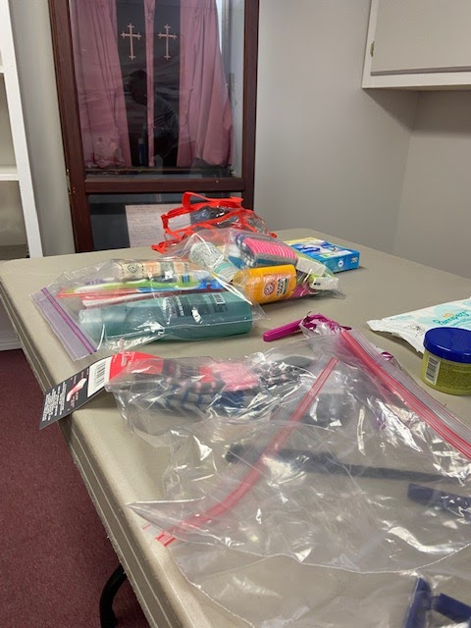
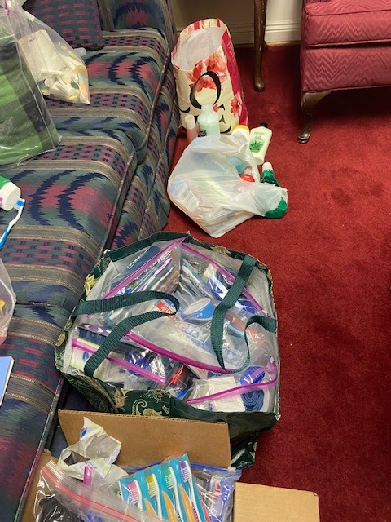

Slide 46
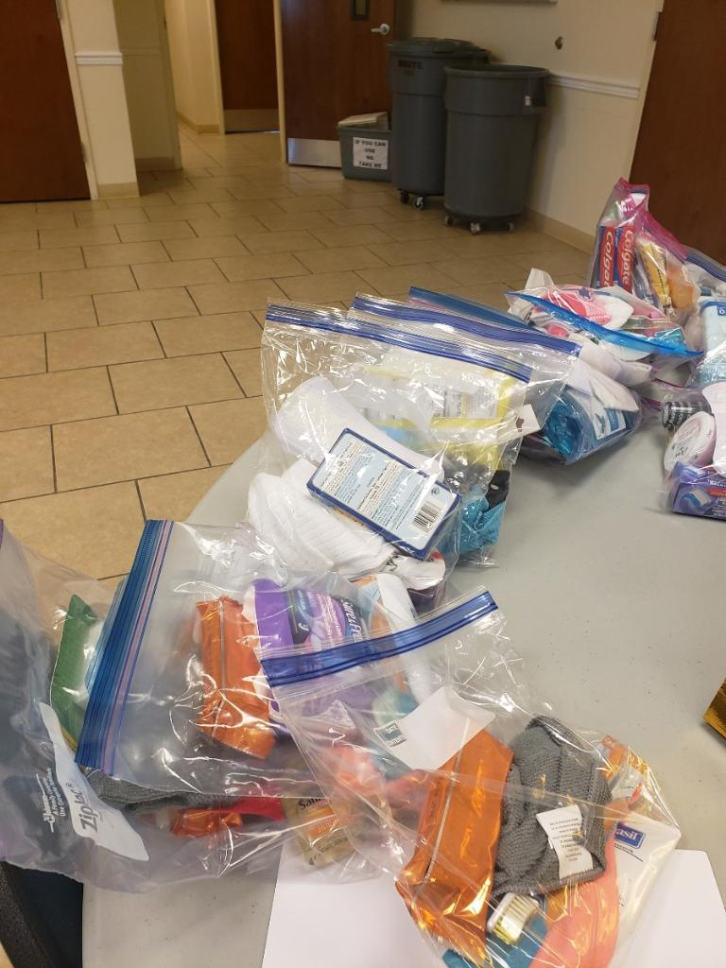
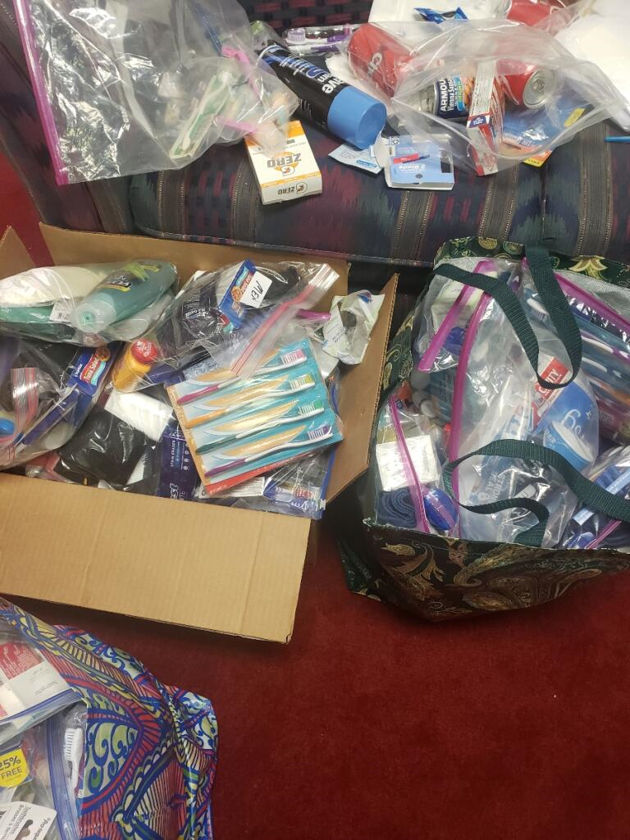

Slide 47
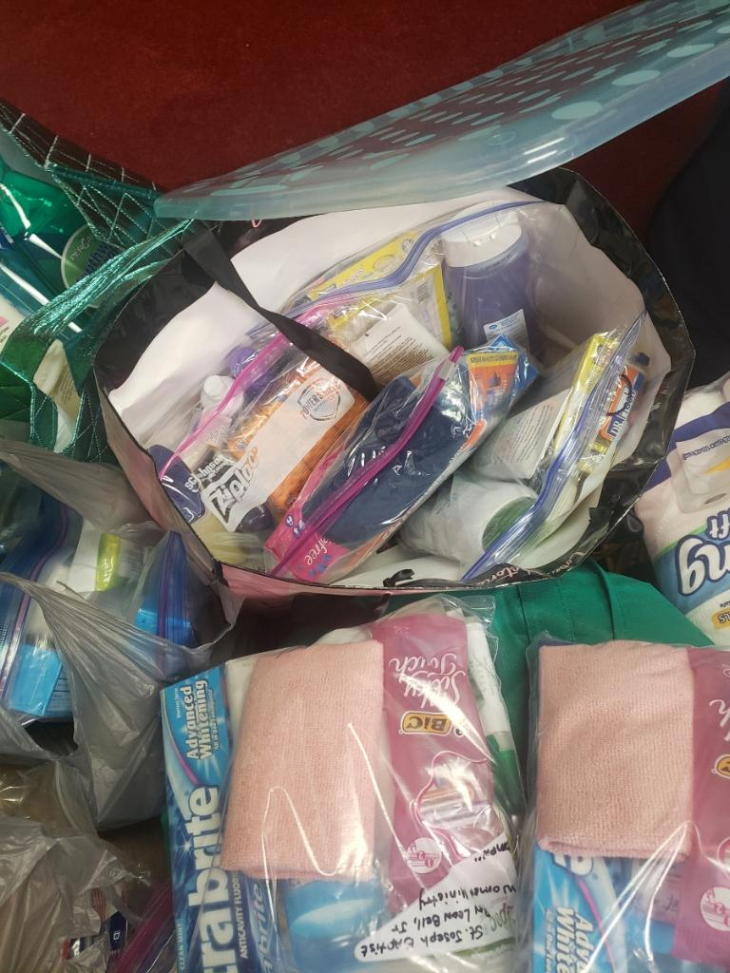
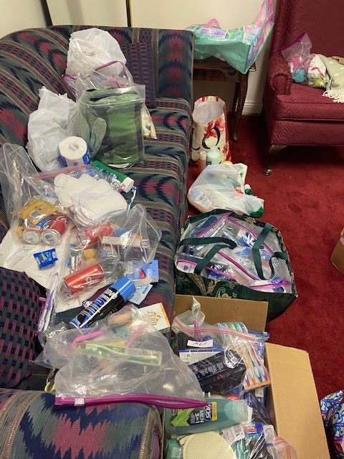

Slide 48
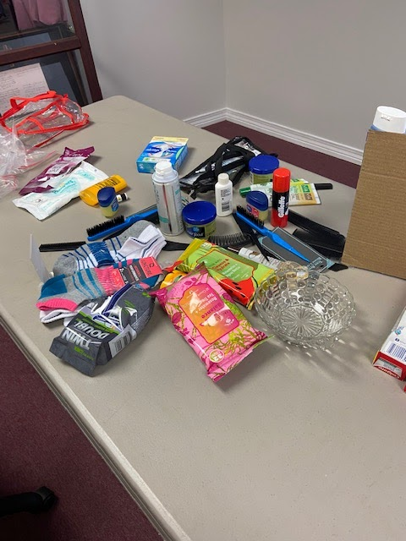
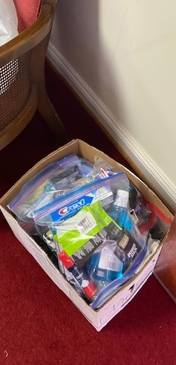
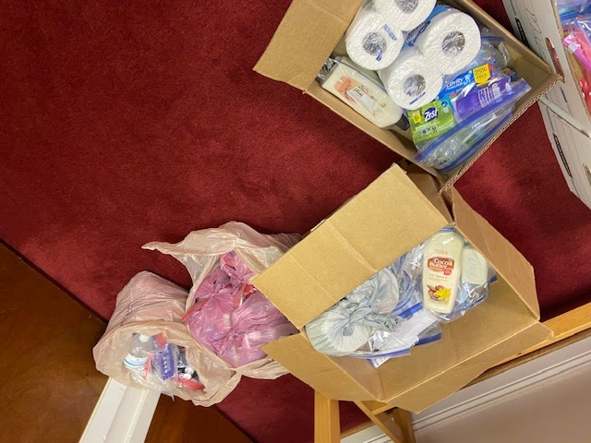

Slide 54
Supporting ONE MEAL A DAY MINISTRY 2023 * 5 Visits*

Slide 72
Supporting St. Louis Street Food Ministry

Slide 78
Supporting
Mobile County
PUBLIC SCHOOLS
2022

Slide 81
Sunlight District Outreach Feeding the Gulf Coast March 2022

Slide 89
Supporting Waterfront Rescue Mission *2 Visits*

Slide 97
Outreach Fashion Share Love Baskets 2021

Slide 107
Mission Of Power Monthly Meeting

Slide 108
Other Activities of the District

Slide 109
TO GOD BE THE GLORY!
I WISH TO THANK THE MODERATOR AND HIS STAFF AND TO ALL OF THE PASTORS AND MINISTERS OF THE MOBILE BAPTIST SUNLIGHT DISTRICT ASSOCIATION WOMAN’S AUXILIARY DEPARTMENT FOR ALL ITEMS COLLECTED BY THE MISSION COORDINATORS FROM OUR CHURCHES MISSION DEPARTMENT FOR THE FASHION SHARE PROJECTS.
THANK YOU AGAIN SUNLIGHT SERVANT LEADERS FOR ANOTHER BLESSED YEAR. BY THE GRACE OF GOD ALONG WITH YOUR TIME, PRAYERS, TALENTS AND RESOURCES WE MADE IT THRU ANOTHER YEARS JOURNEY!!
SPECIAL THANKS TO ALL OF THE VOLUNTEERS THAT WORKED THE
SORTING AND DISTRUBTION SITES FOR ALL OF THE DONATED ITEMS.
THANKS AGAIN TO EVERY MEMBER OF THE DISTRICT FOR ALL YOU DO IN RAISING THE STANDARD IN THE NEW NORMAL WHICH IS
KEEPING THE SUNLIGHT DISTRICT SHINING

