Slide 1
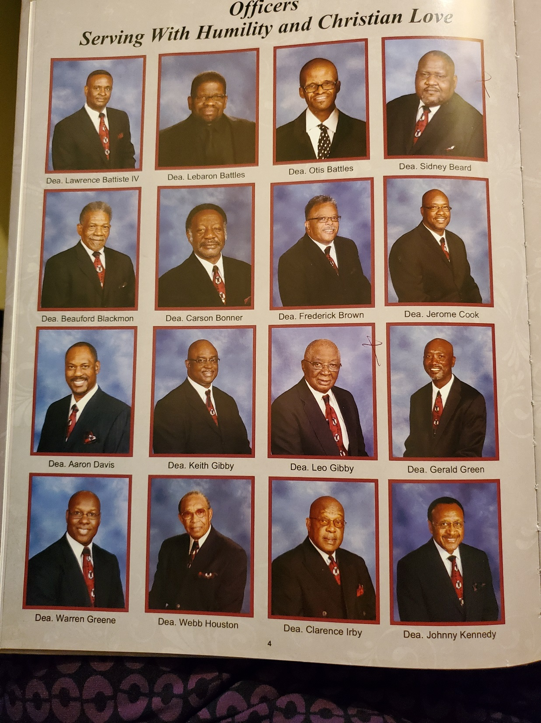
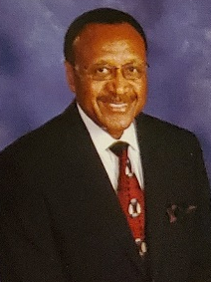
DEACON BOARD
CHAIRMAN
DEACON BOARD
VICE CHAIRMAN
RMBC
DEACON’S WARD
A-Z
M
Deacon Otis E. Battles, Jr.
nelda.battles@bellsouth.net
251-473-6640/656-5760
W
Deacon Johnny P. Kennedy
johnnykennedy@bellsouth.net
251-660-0050/605-9542

Slide 2
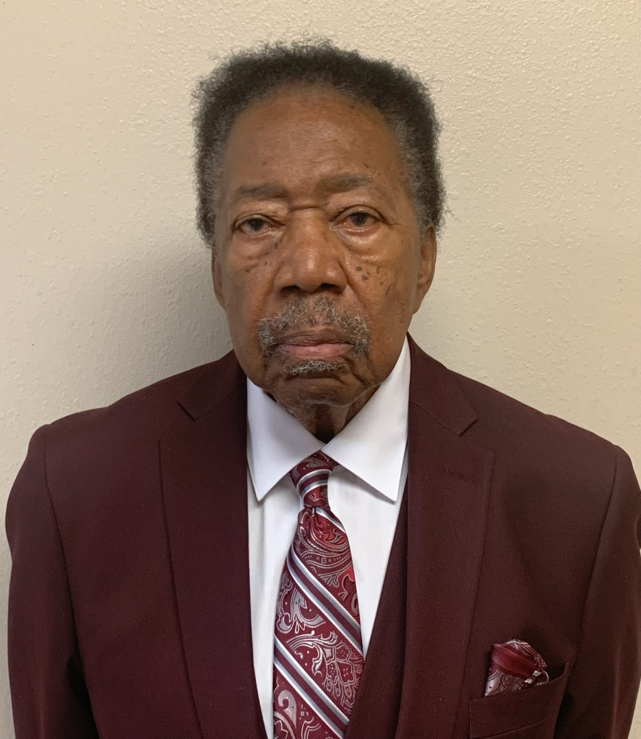
TEAM
A, H
Deacon Lebarron Battles lkbattles76@gmail.com
251-680-9745
A
Deacon William W. Bell
251-604-9099

Slide 3
TEAM
N, Q
Deacon Frederick Brown
frebro58@bellsouth.net
251-479-6493/802-7819
F, I, N, Q
Deacon Warren Greene warreng1911@bellsouth.net
251-751-4259

Slide 4
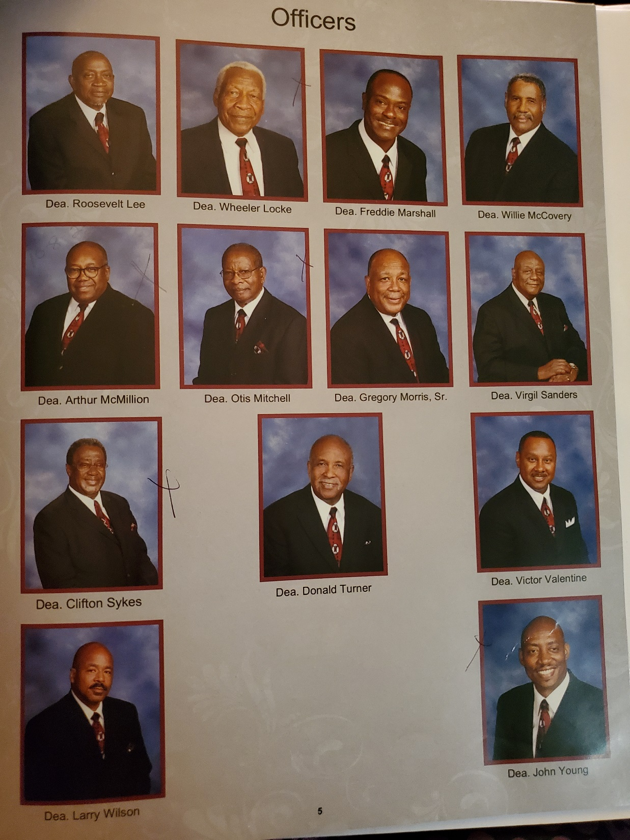
TEAM
S
Deacon Carson
mbonner01@netzero.net
251-666-3131
O, S, U, X, Z
Deacon Gregory Morris, Sr.
diphair@aol.com
251-471-6088/455-6018

Slide 5
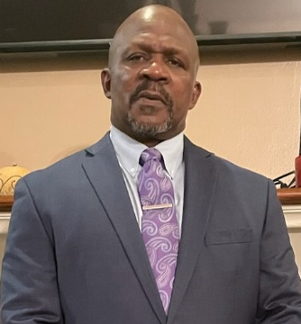
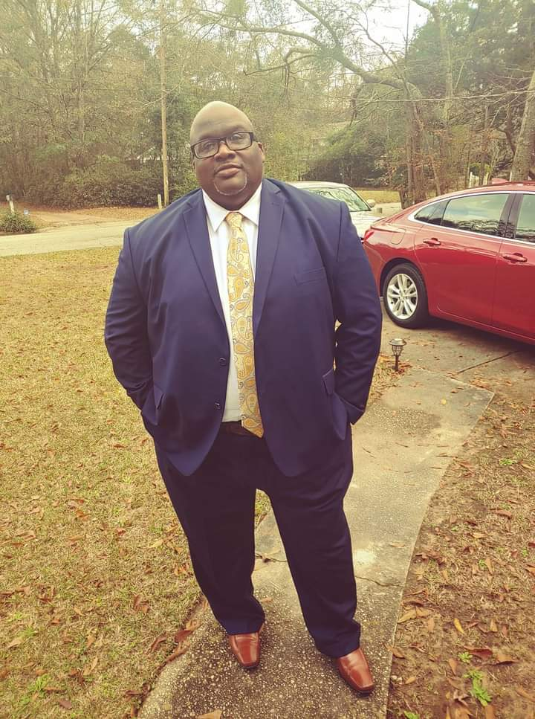
B
Deacon Carl Robinson
carlrobinson365@gmail.com
228-369-5726
C, K
Deacon Wendell Casher
prarchie33@gmail.com
228-623-7310

Slide 6
D
Deacon Larry Wilson
lwilson217@hotmail.com
251-404-4763
E, V, Y
Deacon Clarence Irby clarenceirby@att.net
251-433-4341/605-1323

Slide 7
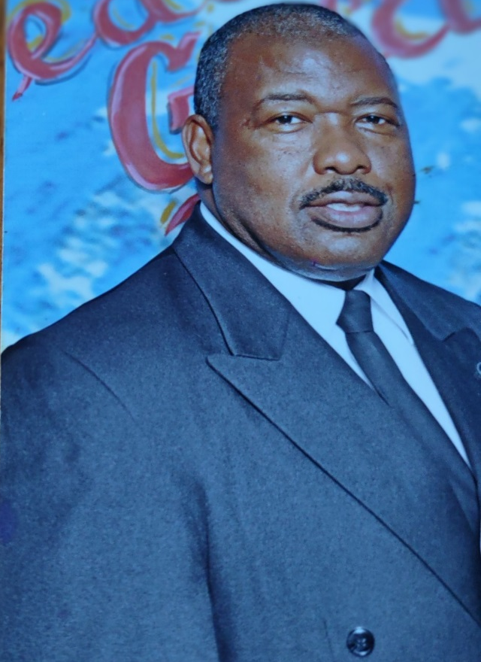
G
Deacon Victor Valentine
victor.vic4vic@gmail.com
251-633-7819/377-2910
J
Deacon Samuel Smith
ssmith552001@yahoo.com
251-604-5238

Slide 8
M
Deacon Lawrence
Battiste, IV
lbattiste3@gmail.com
251-343-8104/654-3265
L
Deacon Keith Gibby
bkeithgibby@comcast.net
251-660-1946/721-4788
P
Deacon Jerome Cook
cook8500@bellsouth.net
251-661-5930/753-8546

Slide 9
R
Deacon Willie McCovery bernestinemccovery43@gmail.com
251-478-1933
T
Deacon Freddie Marshall
Freddie201462@gmail.com
251-471-1774/767-5634

Slide 10
RMBC
DEACON BOARD ALTERNATE CONTACT
If any member can't reach their assigned Deacon, they can:
  Call the Church's Secretary to assist in getting a contact request to him, or
  Contact any Deacon who should either relay the message, help if possible, or contact the Chairman, or Vice-Chairman to coordinate follow-up.

